Slide 1

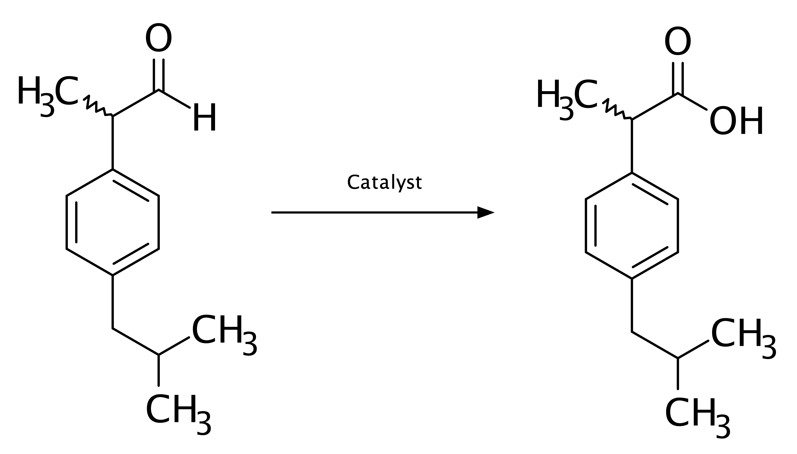
Enzymatic Conversion of Ibuprofen Aldehyde to Ibuprofen
The image depicts a biocatalytic transformation where an enzyme facilitates the conversion of Ibuprofen Aldehyde to Ibuprofen. The reaction involving the oxidation of aldehyde is a key step in the synthesis of the non-steroidal anti-inflammatory drug (NSAID), Ibuprofen. This enzymatic approach offers a selective and environmentally friendly alternative to traditional chemical synthesis, highlighting the potential of biocatalysis in pharmaceutical manufacturing.
Enzyme
Ibuprofen Aldehyde
Ibuprofen

Slide 2
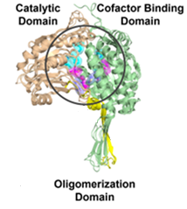
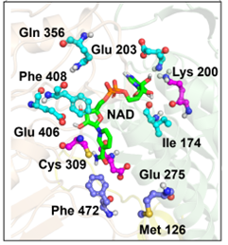
a)
b)
Structural snapshot of aldehyde dehydrogenase enzyme : The image highlights the conserved domains and functional features. a) Wheat: catalytic domain; light green: Cofactor binding domain; yellow: oligomerization domain; b) cyan: cofactor-binding residues; magenta: catalytic triad; light blue: substrate entry/exit channel

Slide 3
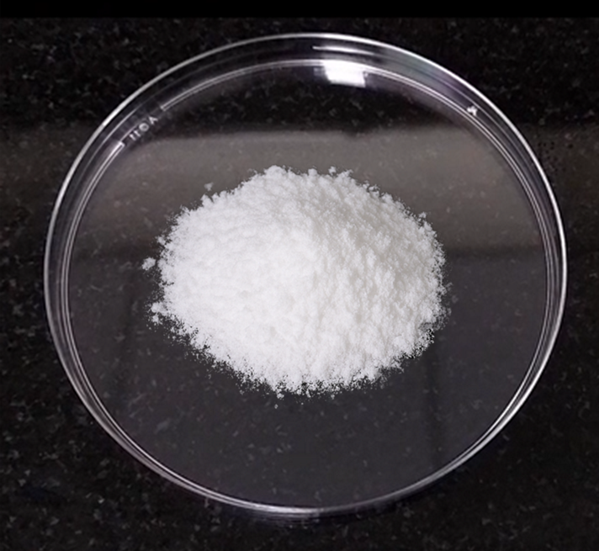
Purified Biocatalysis Product
Image is a petri dish containing a purified white ibuprofen powder, the final product of a biocatalysis reaction. This material was synthesized using enzyme-mediated transformation of organic substrates, a process known for its selectivity and eco-friendly nature.

Slide 4
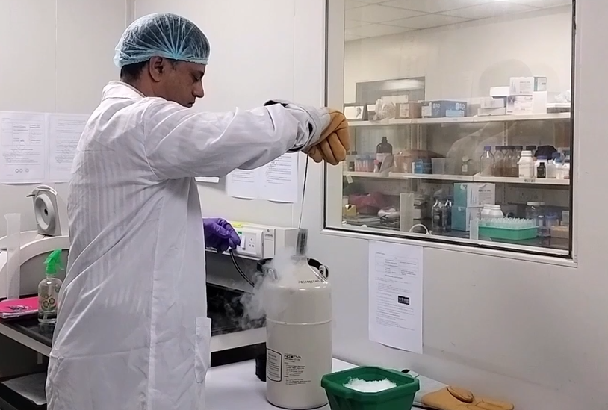
Enzyme retrieval from storage for biocatalysis
In laboratory setup, the scientist is seen retrieving an enzyme sample from a deep freezer, preparing it for use in a biocatalysis experiment. The enzyme, stored at sub-zero temperatures to preserve its activity and stability, plays a crucial role in accelerating specific biochemical reactions. This step marks the beginning of a controlled experimental process aimed at exploring enzymatic efficiency and potential applications in industrial biotransformations.

Slide 5
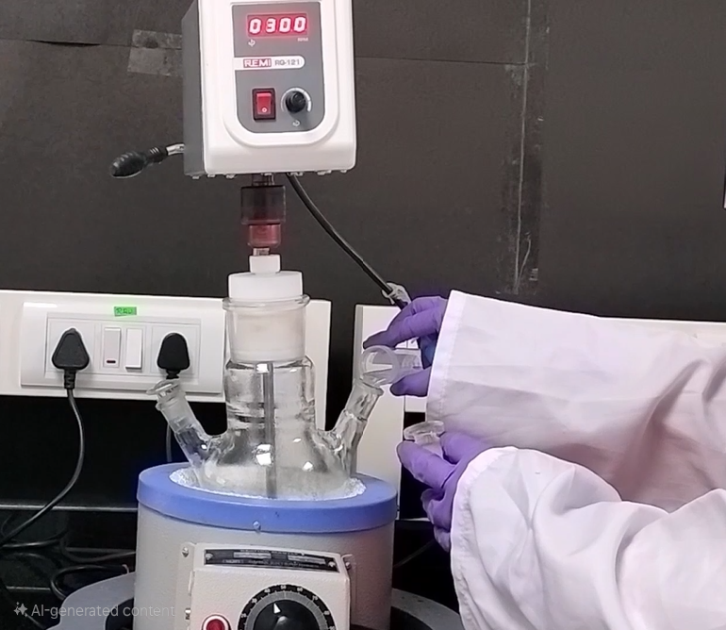
Biocatalysis Reaction Setup
This image captures a controlled laboratory setup for a biocatalysis reaction. This setup is typically used to study enzyme-catalyzed transformations under precise reaction parameters, contributing to advancements in green chemistry and industrial bioprocessing.

